Slide 1
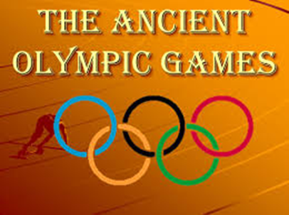
BY :
SUMERA SATTAR
LECTURER HEALTH AND PHYSICAL EDUCATION.
LAHORE COLLEGE FOR WOMEN UNIVERSITY LAHORE.

Slide 12
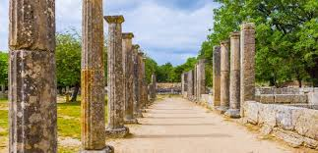
THE CONTEXT OF THE GAMES AND THE OLYMPIC SPIRIT
Today, the Olympic Games are the world's largest pageant of athletic skill and competitive spirit. They are also displays of nationalism, commerce and politics.
These two opposing elements of the Olympics are not a modern invention.
The conflict between the Olympic movement's high ideals.

